Slide 1
Neural Networks
Session 24
Henry Lucky, S.Kom., M.Kom.

Slide 2
Learning Outcomes
Session 24
At the end of this session, students will be able to:
LO 5: Apply various learning algorithms for agents to solve problems

Slide 3
outline
Session 24
Perceptron
Multilayer Perceptron
Artificial Neural Network
Backpropagation Neural Network (BPNN)

Slide 4
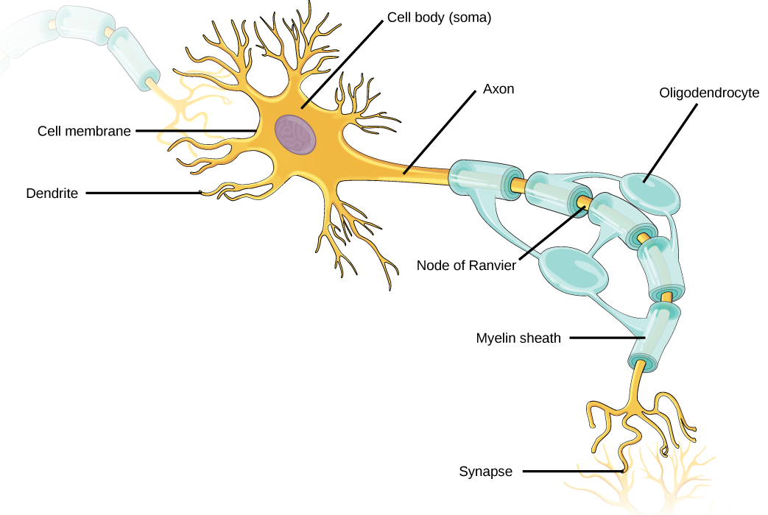
Artificial Neural network
Neuron
A human brain is a complex organization of a cell called as neuron.
A neuron can process information by running this process:
Receive signals from other neurons via dendrites,
Tweak the signals in its cell body,
Send new signals to other neurons via synaptic terminals

Slide 5
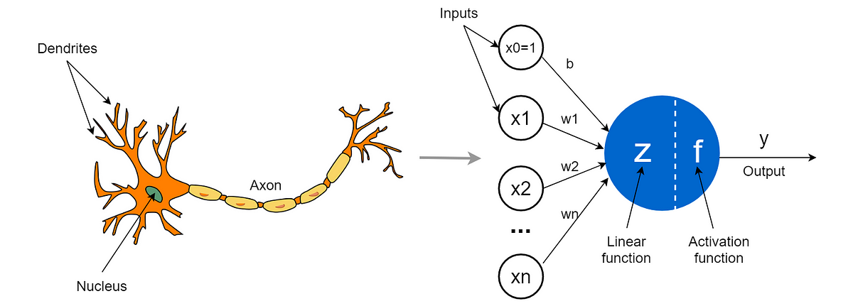
Artificial Neural network
intro
ANNs are a computational model inspired by the structure and function of biological neural networks in the human brain.
Here is the comparation between biological neuron and artificial neuron:

Slide 6
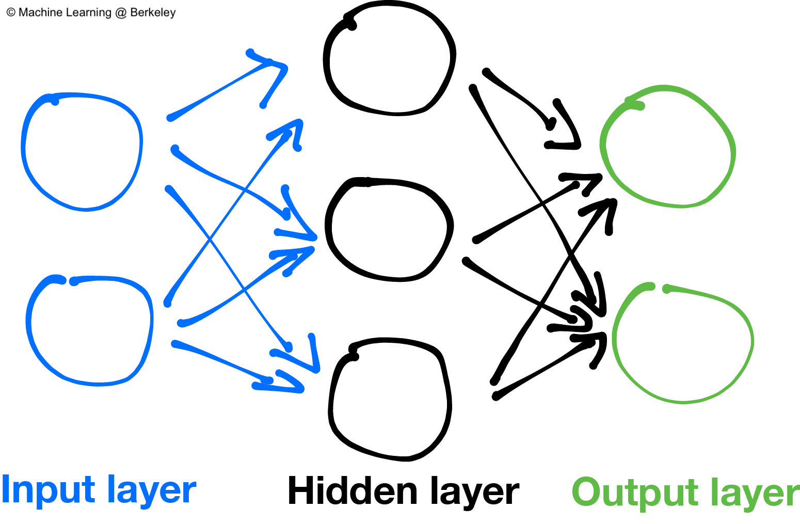
Artificial Neural network
structure
In ANN, the neurons are interconnected and organized in layers.
Information flows through the network from input layers to output layers.
Typical ANN has 3 layers: Input, Hidden and Output layers.

Slide 7
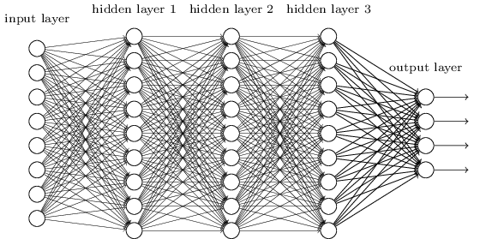
Artificial Neural network
Deep learning
Deep learning revolves around ANN with multiple hidden layers (hence "deep"),
It can learn complex patterns in data.
It can automatically learn features from raw data, eliminating the need for manual feature extraction.

Slide 8
Perceptron
Definition
One of the early attempts to build an artificial neuron is that of Frank Rosenblatt.
Rosenblatt proposed a method called the perceptron, which became known as the first artificial neuron.
The algorithm is a type of linear classifier that learns a decision boundary for binary classification tasks
Its architecture is composed of an augmentation of two functions:
  A linear transformation
  A thresholding Function

Slide 9
Perceptron
Rosenblatt’s perceptron

Slide 10

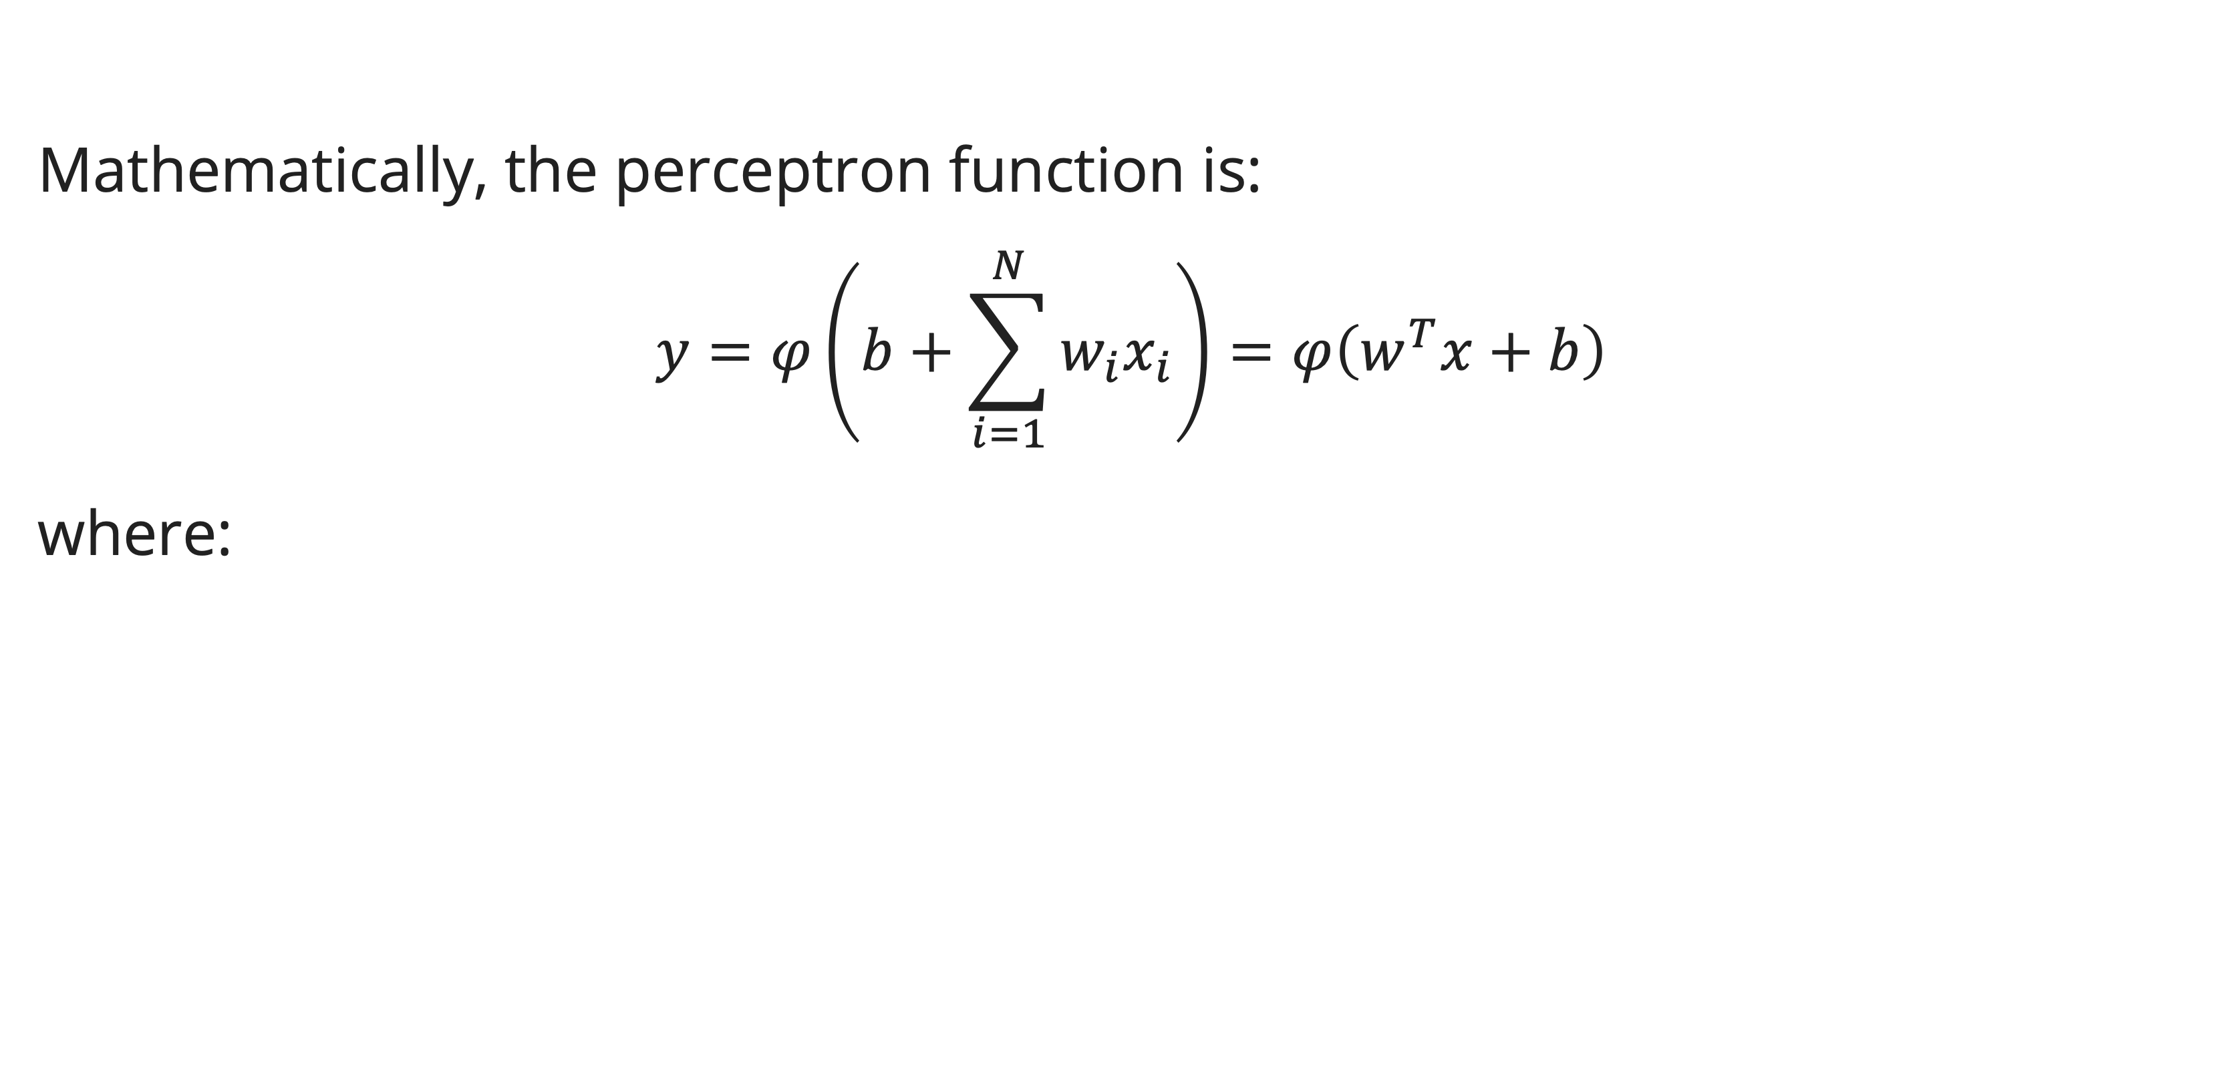
Perceptron
function
Mathematically, the perceptron function is:
$$y=φ\left(b+\sum_{i=1}^{N}{w_{i}x_{i}}\right)=φ\left(w^{T}x+b\right)$$
where:

Slide 11
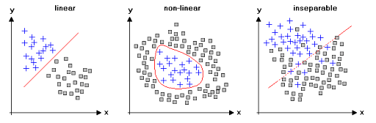
Perceptron
Problem and limitation
The perceptron algorithm, and architecture, has a major limitation, its inability to deal with non-linearly separable pattern.
This drawback restricts the use of Rosenblatt’s perceptron to simple tasks

Slide 12
Perceptron
Activation function
To deal with such issue (non-linear pattern), artificial neurons tweak the perceptron architecture to include a differentiable activation function that replaces the thresholding function to add non-linearity.
Activation function is a non-linear operation applied on the output of the combiner.
It serves two objectives:
  Provides control over the range of the output (activation range)
  It helps expand the representational ability of neural networks beyond linearly-separable patterns

Slide 13
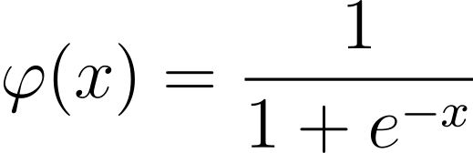
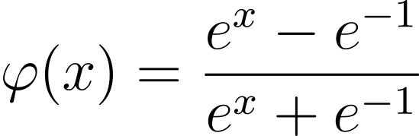

Perceptron
Activation function
Three of the most popular activations:
  Sigmoid function:
  Hyperbolic tangent function (tanh):
  Rectified Linear Unit (ReLU):

Slide 14
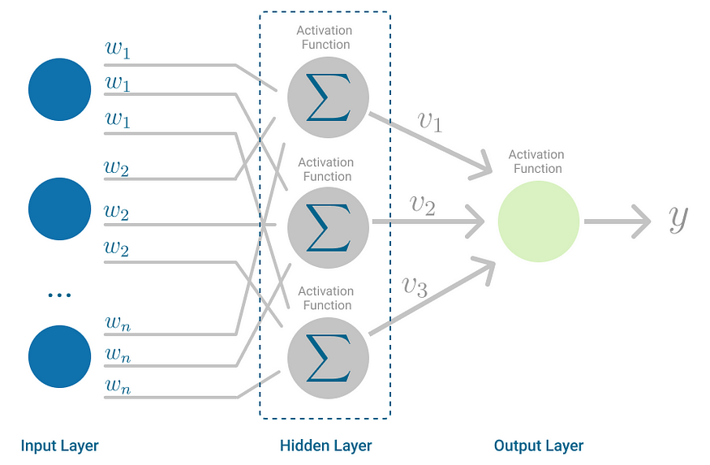
Multilayer perceptron
definition
The Multilayer Perceptron is a neural network where the mapping between inputs and output is non-linear.
A Multilayer Perceptron has input and output layers, and one or more hidden layers with many neurons stacked together.

Slide 15
Multilayer perceptron
algorithm
The Multilayer Perceptron is classified as a feedforward algorithm due to its characteristic of combining inputs with initial weights in a weighted sum and subsequently applying an activation function, similar to the Perceptron.
Nevertheless, if the algorithm solely performed calculations of weighted sums within each neuron, transmitted the outcomes to the output layer, and terminated the process, it would be unable of acquiring the weights that effectively minimize the cost function.
The above problem could be solved by backpropagation algorithm which updates the weights to minimize a cost function/error.

Slide 16
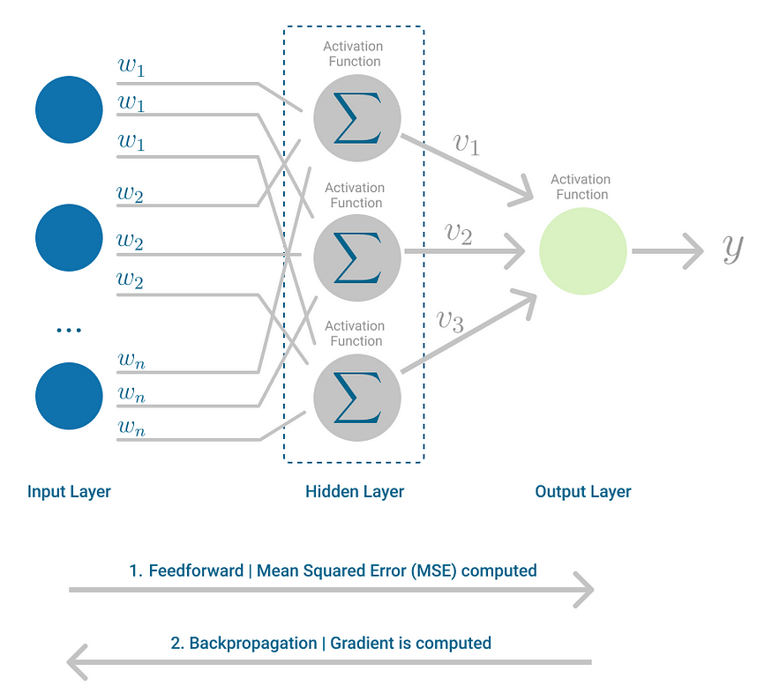
backpropagation
Definition
Backpropagation is the learning mechanism that allows the Multilayer Perceptron to iteratively adjust the weights in the network, with the goal of minimizing the cost function.
It is done in 2 steps: Forward Propagation (Feed Forward) & Backpropagation

Slide 17
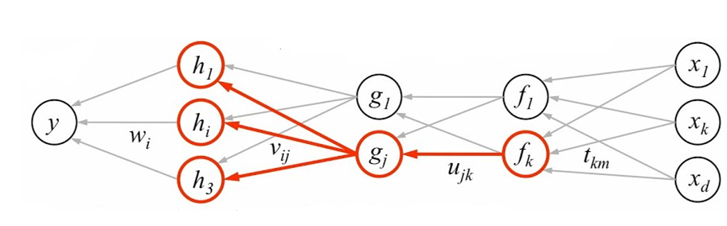
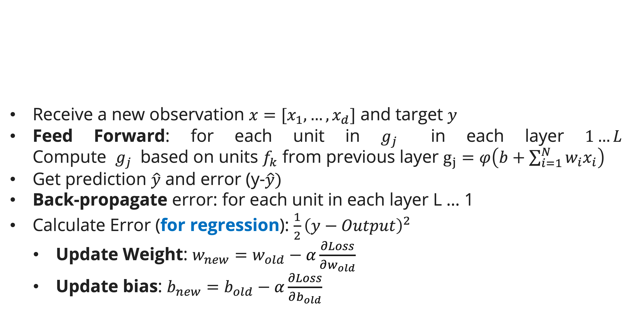
Backpropagation
algorithm
Receive a new observation $x=[x_{1}, …, x_{d}]$ and target $y$
Feed Forward: for each unit in $g_{j}$ in each layer $1…L$
Compute $g_{j}$ based on units $f_{k}$ from previous layer $g_{j}=φ\left(b+\sum_{i=1}^{N}{w_{i}x_{i}}\right)$
Get prediction $\hat{y}$ and error (y-$\hat{y})$
Back-propagate error: for each unit in each layer L … 1
  Calculate Error (for regression): $\frac{1}{2}{\left(y−Output\right)}^{2}$
    Update Weight: $w_{new}=w_{old}−α\frac{∂Loss}{∂w_{old}}$
    Update bias: $b_{new}=b_{old}−α\frac{∂Loss}{∂b_{old}}$

Slide 18






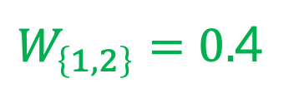



backpropagation
example
We’ll try to simulate ANN algorithm in a regression task.
A multilayer perceptron network has the following configuration:
  $α$ = 0.5 (Learning rate)
  Activation function:
    Hidden Layer: Sigmoid
    Output Layer: Linear
We have data:
  Input: x1 = 0.5, x2 = 0.6
  Expected Output: y = 0.5
b
b
$$b_{\left\{1\right\}}=0.1$$
$$b_{\left\{2\right\}}=0.2$$
$$b_{\left\{3\right\}}=0.05$$
$$W_{\left\{1,1\right\}}=0.5$$
H1
$$W_{\left\{1,O\right\}}=0.3$$
X1
O
$W_{\left\{1,2\right\}}=0.$4
H2
$$W_{\left\{2,O\right\}}=−0.5$$
$$W_{\left\{2,1\right\}}=0.1$$
X2
$$W_{\left\{2,2\right\}}=−0.6$$

Slide 19
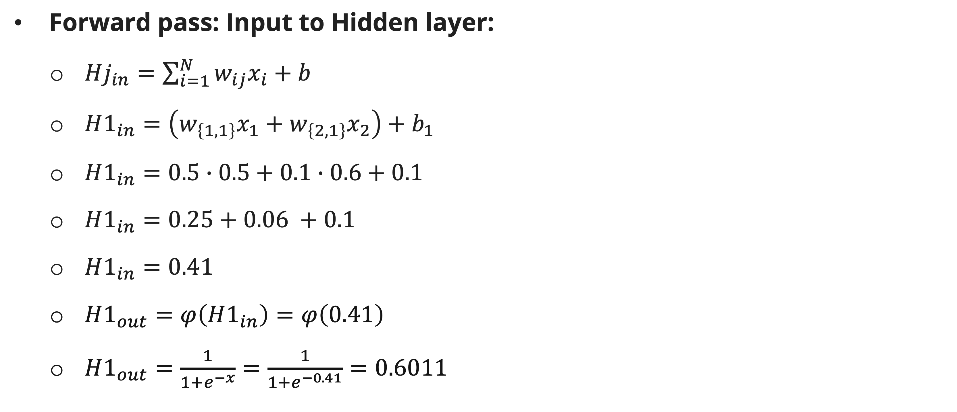
backpropagation
example
Forward pass: Input to Hidden layer:
  $Hj_{in}=\sum_{i=1}^{N}{w_{ij}x_{i}}+b$
  $H1_{in}=\left(w_{\left\{1,1\right\}}x_{1}+w_{\left\{2,1\right\}}x_{2}\right)+b_{1}$
  $H1_{in}=0.5∙0.5+0.1∙0.6+0.1$
  $H1_{in}=0.25+0.06 +0.1$
  $H1_{in}=0.41$
  $H1_{out}=φ\left(H1_{in}\right)=φ\left(0.41\right)$
  $H1_{out}=\frac{1}{1+e^{−x}}=\frac{1}{1+e^{−0.41}}=0.6011$

Slide 20
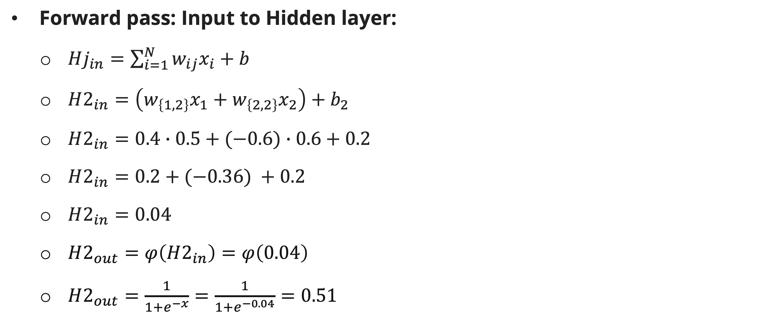
backpropagation
example
Forward pass: Input to Hidden layer:
  $Hj_{in}=\sum_{i=1}^{N}{w_{ij}x_{i}}+b$
  $H2_{in}=\left(w_{\left\{1,2\right\}}x_{1}+w_{\left\{2,2\right\}}x_{2}\right)+b_{2}$
  $H2_{in}=0.4∙0.5+(−0.6)∙0.6+0.2$
  $H2_{in}=0.2+(−0.36) +0.2$
  $H2_{in}=0.04$
  $H2_{out}=φ\left(H2_{in}\right)=φ\left(0.04\right)$
  $H2_{out}=\frac{1}{1+e^{−x}}=\frac{1}{1+e^{−0.04}}=0.51$

Slide 21
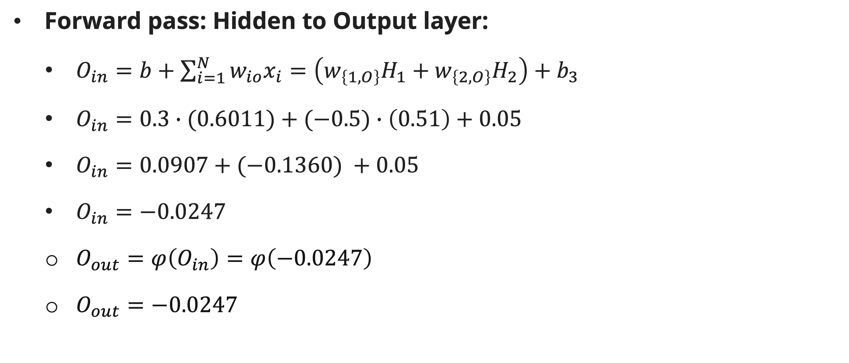
backpropagation
example
Forward pass: Hidden to Output layer:
  $O_{in}=b+\sum_{i=1}^{N}{w_{io}x_{i}}=\left(w_{\left\{1,O\right\}}H_{1}+w_{\left\{2,O\right\}}H_{2}\right)+b_{3}$
  $O_{in}=0.3∙(0.6011)+(−0.5)∙\left(0.51\right)+0.05$
  $O_{in}=0.0907+(−0.1360) +0.05$
  $O_{in}=−0.0247$
  $O_{out}=φ\left(O_{in}\right)=φ\left(−0.0247\right)$
  $O_{out}=−0.0247$

Slide 22

backpropagation
example
Calculate Loss/Error
  $Loss=\frac{1}{2}\left(y−\hat{y}\right)$
  $Loss=\frac{1}{2}{\left(y−O_{out}\right)}^{2}$
  $Loss =\frac{1}{2}{\left(0.5−(−0.0247)\right)}^{2}$
  $Loss=0.1377$

Slide 23
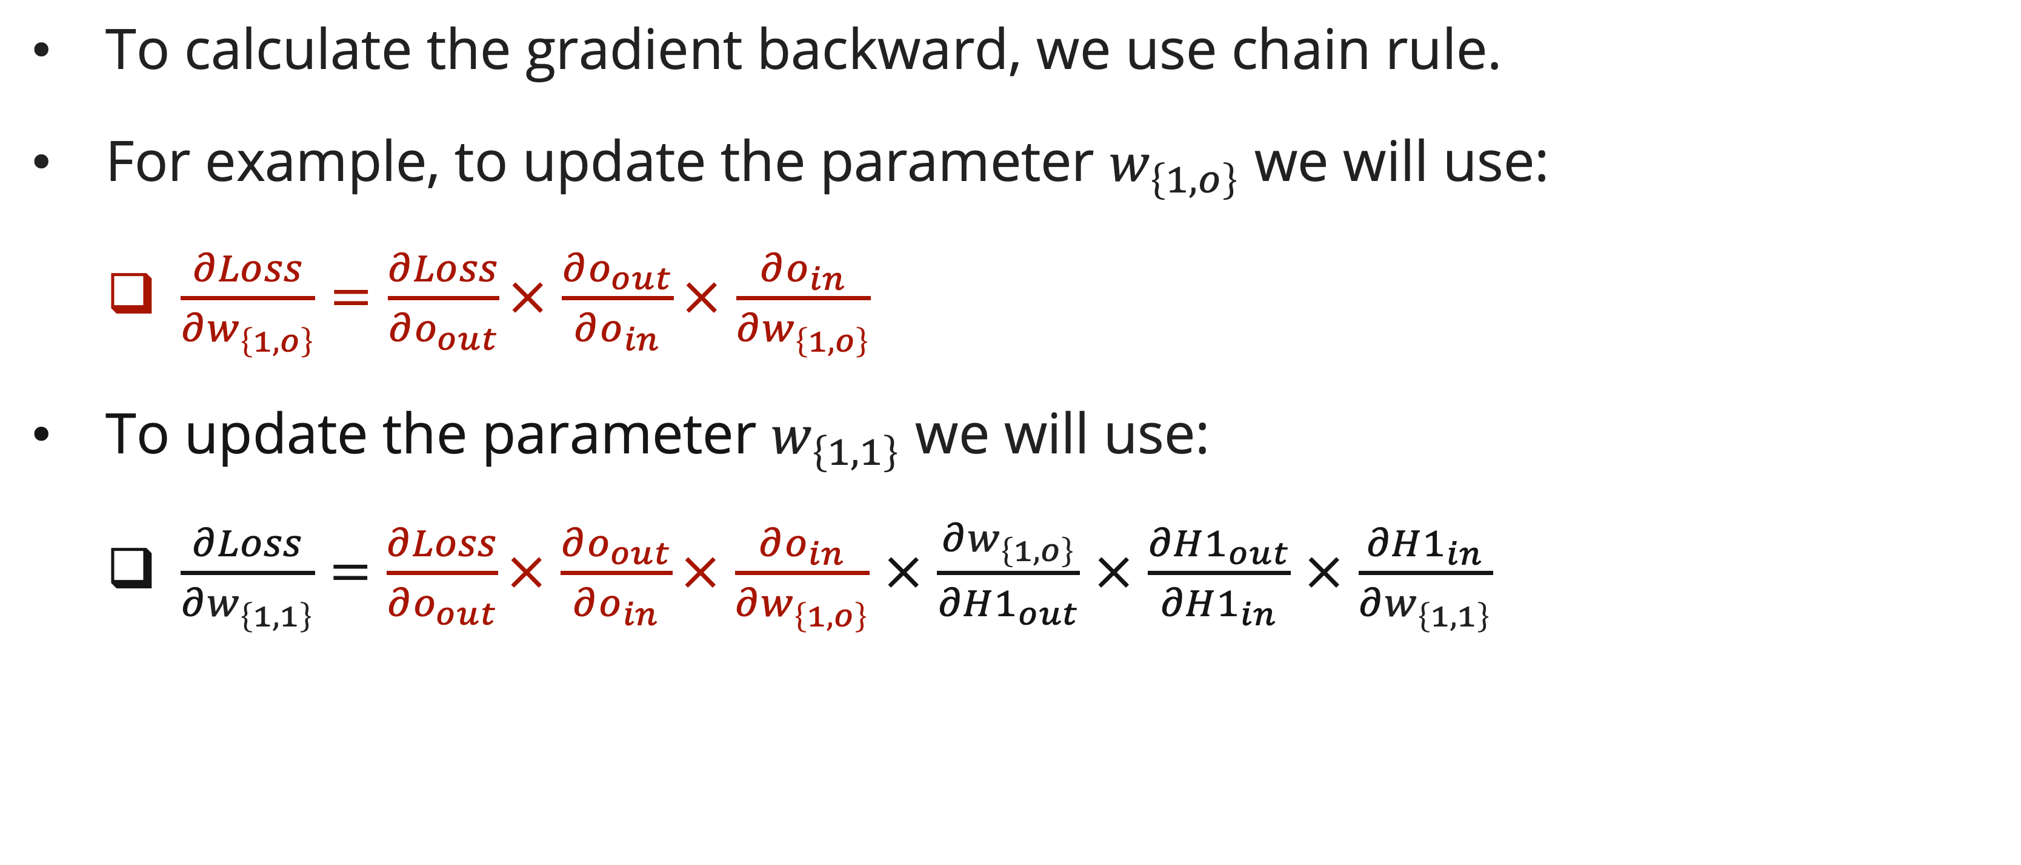
backpropagation
Chain rule
To calculate the gradient backward, we use chain rule.
For example, to update the parameter $w_{\left\{1,o\right\}}$ we will use:
  $\frac{∂Loss}{∂w_{\left\{1,o\right\}}}=\frac{∂Loss}{∂o_{out}}×$ $\frac{∂o_{out}}{∂o_{in}}×$ $\frac{∂o_{in}}{∂w_{\left\{1,o\right\}}}$
To update the parameter $w_{\left\{1,1\right\}}$ we will use:
  $\frac{∂Loss}{∂w_{\left\{1,1\right\}}}=\frac{∂Loss}{∂o_{out}}×$ $\frac{∂o_{out}}{∂o_{in}}×$ $\frac{∂o_{in}}{∂w_{\left\{1,o\right\}}}$ $×$ $\frac{∂w_{\left\{1,o\right\}}}{∂H1_{out}}$ $×$ $\frac{∂H1_{out}}{∂H1_{in}}$ $×$ $\frac{∂H1_{in}}{∂w_{\left\{1,1\right\}}}$

Slide 24
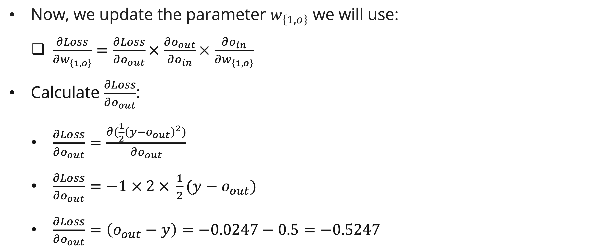
backpropagation
example
Now, we update the parameter $w_{\left\{1,o\right\}}$ we will use:
  $\frac{∂Loss}{∂w_{\left\{1,o\right\}}}=\frac{∂Loss}{∂o_{out}}×$ $\frac{∂o_{out}}{∂o_{in}}×$ $\frac{∂o_{in}}{∂w_{\left\{1,o\right\}}}$
Calculate $\frac{∂Loss}{∂o_{out}}$:
  $\frac{∂Loss}{∂o_{out}}=\frac{∂(\frac{1}{2}{\left(y−o_{out}\right)}^{2})}{∂o_{out}}$
  $\frac{∂Loss}{∂o_{out}}=−1 × 2 × \frac{1}{2}(y−o_{out})$
  $\frac{∂Loss}{∂o_{out}}=\left(o_{out}−y\right)=−0.0247−0.5=−0.5247$

Slide 25
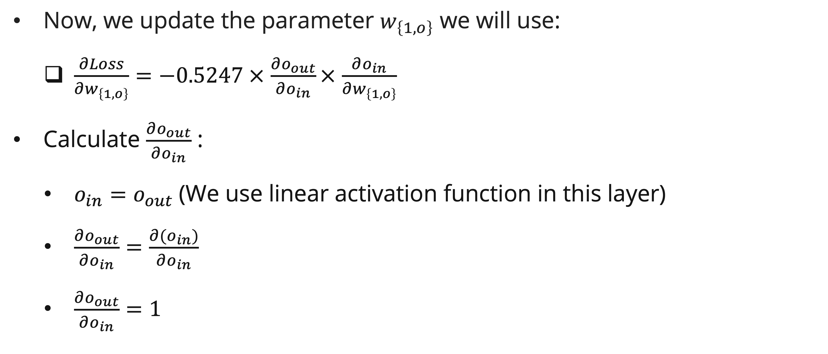
backpropagation
example
Now, we update the parameter $w_{\left\{1,o\right\}}$ we will use:
  $\frac{∂Loss}{∂w_{\left\{1,o\right\}}}=−0.5247 ×$ $\frac{∂o_{out}}{∂o_{in}}×$ $\frac{∂o_{in}}{∂w_{\left\{1,o\right\}}}$
Calculate $\frac{∂o_{out}}{∂o_{in}}$ :
  $o_{in}=o_{out}$ (We use linear activation function in this layer)
  $\frac{∂o_{out}}{∂o_{in}}=\frac{∂{(o}_{in})}{∂o_{in}}$
  $\frac{∂o_{out}}{∂o_{in}}=1$

Slide 26
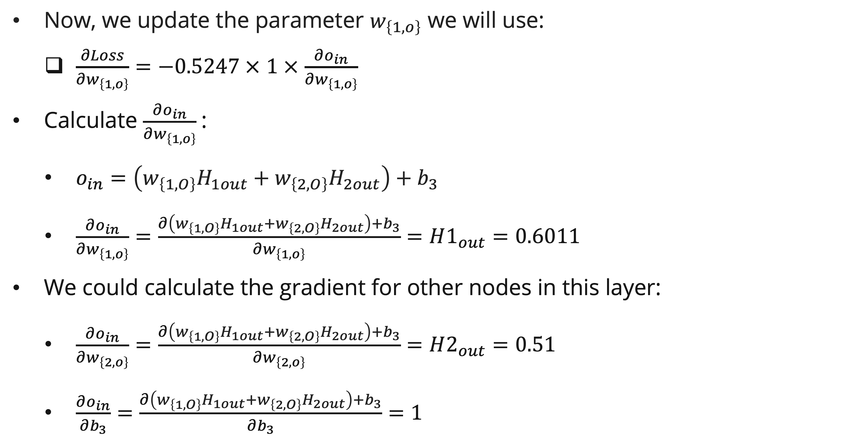
backpropagation
example
Now, we update the parameter $w_{\left\{1,o\right\}}$ we will use:
  $\frac{∂Loss}{∂w_{\left\{1,o\right\}}}=−0.5247 ×$ $1 ×$ $\frac{∂o_{in}}{∂w_{\left\{1,o\right\}}}$
Calculate $\frac{∂o_{in}}{∂w_{\left\{1,o\right\}}}$:
  $o_{in}=\left(w_{\left\{1,O\right\}}H_{1out}+w_{\left\{2,O\right\}}H_{2out}\right)+b_{3}$
  $\frac{∂o_{in}}{∂w_{\left\{1,o\right\}}}=\frac{∂\left(w_{\left\{1,O\right\}}H_{1out}+w_{\left\{2,O\right\}}H_{2out}\right)+b_{3}}{∂w_{\left\{1,o\right\}}}=H1_{out}=0.6011$
We could calculate the gradient for other nodes in this layer:
  $\frac{∂o_{in}}{∂w_{\left\{2,o\right\}}}=\frac{∂\left(w_{\left\{1,O\right\}}H_{1out}+w_{\left\{2,O\right\}}H_{2out}\right)+b_{3}}{∂w_{\left\{2,o\right\}}}=H2_{out}=0.51$
  $\frac{∂o_{in}}{∂b_{3}}=\frac{∂\left(w_{\left\{1,O\right\}}H_{1out}+w_{\left\{2,O\right\}}H_{2out}\right)+b_{3}}{∂b_{3}}=1$

Slide 27
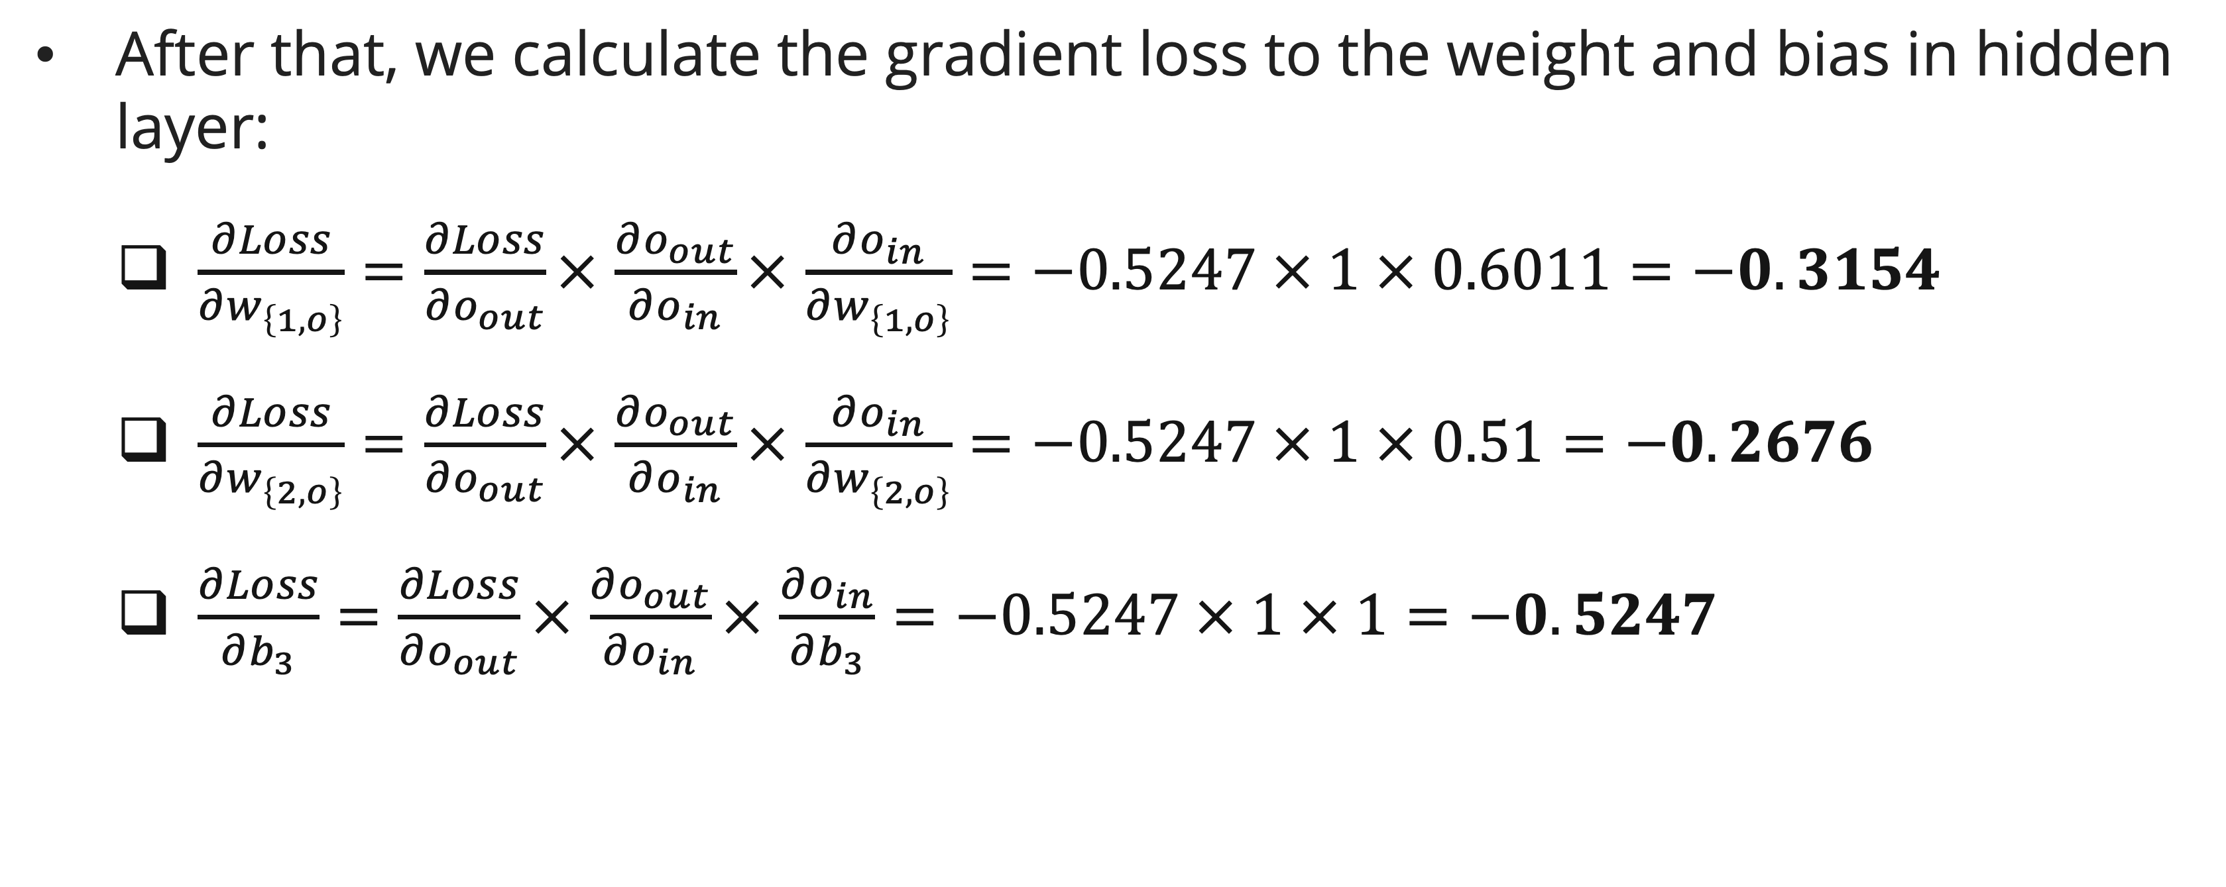
backpropagation
example
After that, we calculate the gradient loss to the weight and bias in hidden layer:
  $\frac{∂Loss}{∂w_{\left\{1,o\right\}}}=\frac{∂Loss}{∂o_{out}}×$ $\frac{∂o_{out}}{∂o_{in}}×$ $\frac{∂o_{in}}{∂w_{\left\{1,o\right\}}}=−0.5247 × 1 × 0.6011=−0.3154$
  $\frac{∂Loss}{∂w_{\left\{2,o\right\}}}=\frac{∂Loss}{∂o_{out}}×$ $\frac{∂o_{out}}{∂o_{in}}×$ $\frac{∂o_{in}}{∂w_{\left\{2,o\right\}}}=−0.5247 × 1 × 0.51=−0.2676$
  $\frac{∂Loss}{∂b_{3}}=\frac{∂Loss}{∂o_{out}}×$ $\frac{∂o_{out}}{∂o_{in}}×$ $\frac{∂o_{in}}{∂b_{3}}=−0.5247 × 1 × 1=−0.5247$

Slide 28
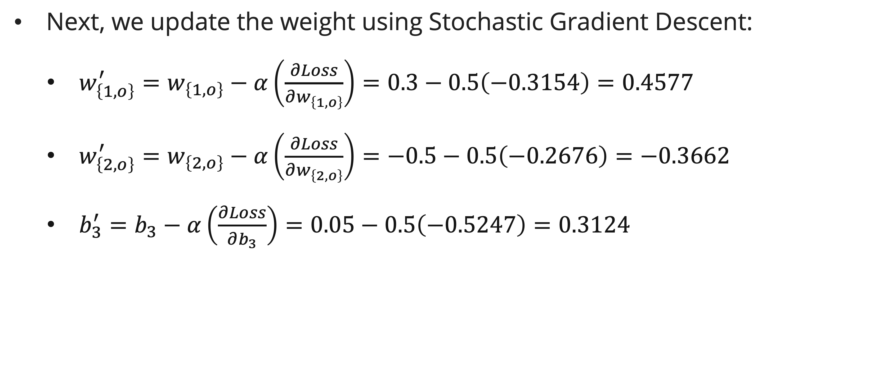
backpropagation
Example: SGD Update
Next, we update the weight using Stochastic Gradient Descent:
  $w_{\left\{1,o\right\}}^{′}=w_{\left\{1,o\right\}}−α\left(\frac{∂Loss}{∂w_{\left\{1,o\right\}}}\right)=0.3−0.5\left(−0.3154\right)=0.4577$
  $w_{\left\{2,o\right\}}^{′}=w_{\left\{2,o\right\}}−α\left(\frac{∂Loss}{∂w_{\left\{2,o\right\}}}\right)=−0.5−0.5\left(−0.2676\right)=−0.3662$
  $b_{3}^{′}=b_{3}−α\left(\frac{∂Loss}{∂b_{3}}\right)=0.05−0.5\left(−0.5247\right)=0.3124$

Slide 29
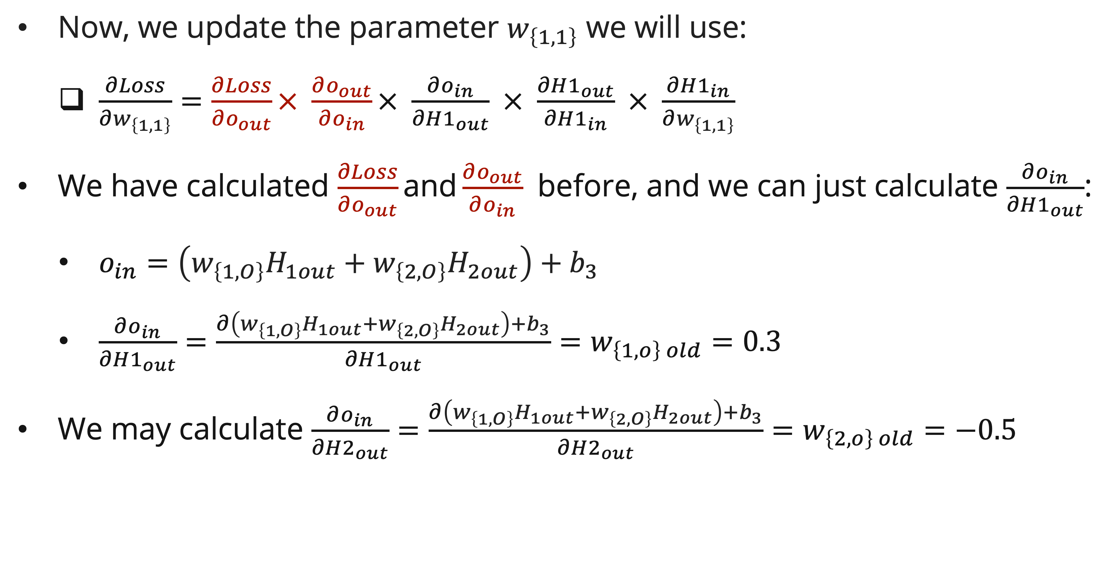
backpropagation
example
Now, we update the parameter $w_{\left\{1,1\right\}}$ we will use:
  $\frac{∂Loss}{∂w_{\left\{1,1\right\}}}=\frac{∂Loss}{∂o_{out}}× \frac{∂o_{out}}{∂o_{in}}× \frac{∂o_{in}}{∂H1_{out}} × \frac{∂H1_{out}}{∂H1_{in}} × \frac{∂H1_{in}}{∂w_{\left\{1,1\right\}}}$
We have calculated $\frac{∂Loss}{∂o_{out}}\text{and}\frac{∂o_{out}}{∂o_{in}}$ before, and we can just calculate $\frac{∂o_{in}}{∂H1_{out}}$:
  $o_{in}=\left(w_{\left\{1,O\right\}}H_{1out}+w_{\left\{2,O\right\}}H_{2out}\right)+b_{3}$
  $\frac{∂o_{in}}{∂H1_{out}}=\frac{∂\left(w_{\left\{1,O\right\}}H_{1out}+w_{\left\{2,O\right\}}H_{2out}\right)+b_{3}}{∂H1_{out}}=w_{\left\{1,o\right\} old}=0.3$
We may calculate $\frac{∂o_{in}}{∂H2_{out}}=\frac{∂\left(w_{\left\{1,O\right\}}H_{1out}+w_{\left\{2,O\right\}}H_{2out}\right)+b_{3}}{∂H2_{out}}=w_{\left\{2,o\right\} old}=−0.5$

Slide 30
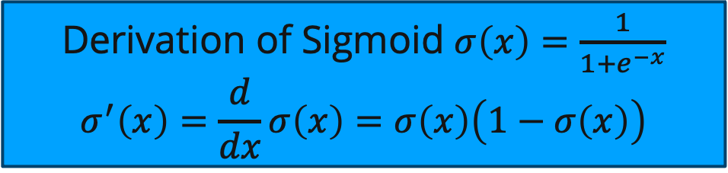
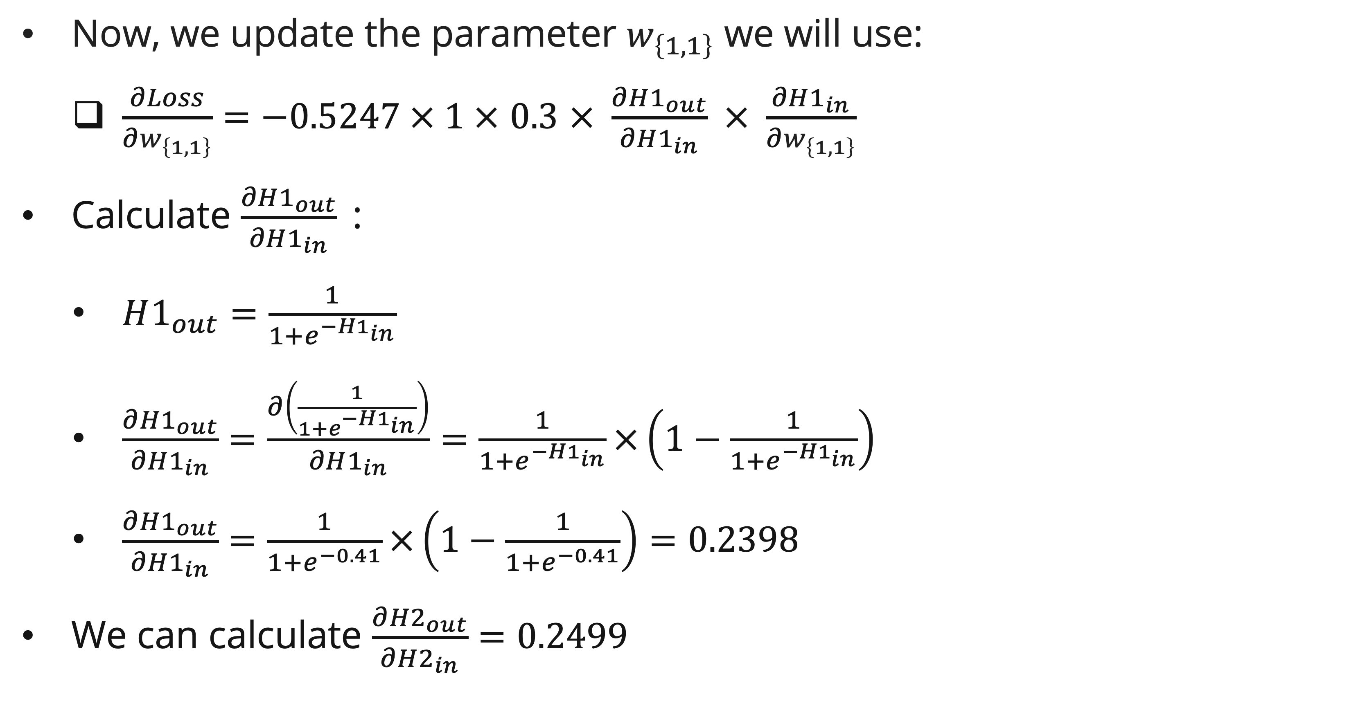
backpropagation
example
Now, we update the parameter $w_{\left\{1,1\right\}}$ we will use:
  $\frac{∂Loss}{∂w_{\left\{1,1\right\}}}=−0.5247 × 1 × 0.3 × \frac{∂H1_{out}}{∂H1_{in}} × \frac{∂H1_{in}}{∂w_{\left\{1,1\right\}}}$
Calculate $\frac{∂H1_{out}}{∂H1_{in}}$:
  $H1_{out}=\frac{1}{1+e^{−H1_{in}}}$
  $\frac{∂{H1}_{out}}{∂H1_{in}}=\frac{∂\left(\frac{1}{1+e^{−H1_{in}}}\right)}{∂H1_{in}}=\frac{1}{1+e^{−H1_{in}}}×\left(1−\frac{1}{1+e^{−H1_{in}}}\right)$
  $\frac{∂{H1}_{out}}{∂H1_{in}}=\frac{1}{1+e^{−0.41}}×\left(1−\frac{1}{1+e^{−0.41}}\right)=0.2398$
We can calculate $\frac{∂{H2}_{out}}{∂H2_{in}}=0.2499$
Derivation of Sigmoid $σ\left(x\right)=\frac{1}{1+e^{−x}}$
$$σ^{′}\left(x\right)=\frac{d}{dx}σ\left(x\right)=σ\left(x\right)\left(1−σ\left(x\right)\right)$$

Slide 31
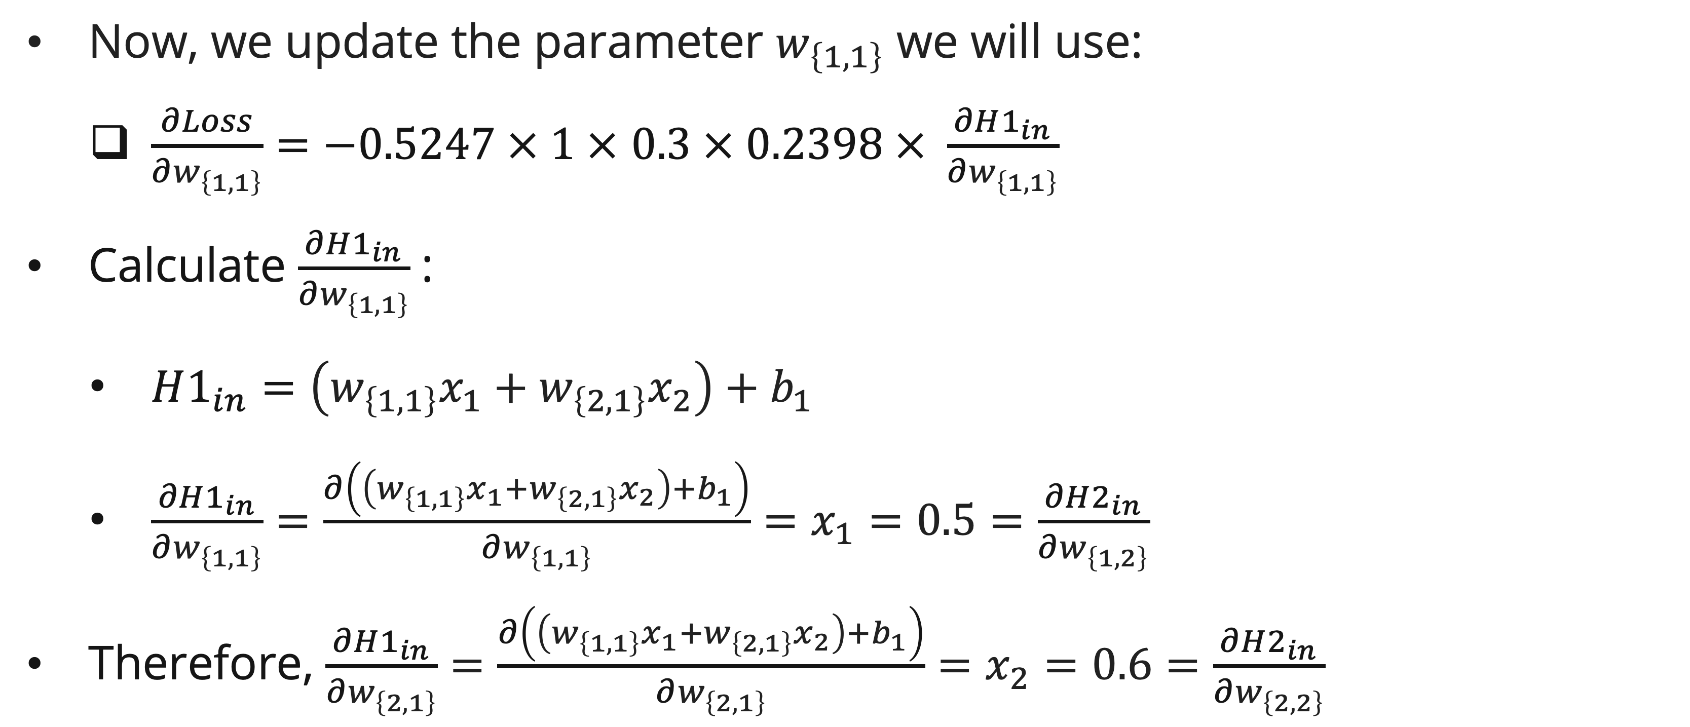
backpropagation
example
Now, we update the parameter $w_{\left\{1,1\right\}}$ we will use:
  $\frac{∂Loss}{∂w_{\left\{1,1\right\}}}=−0.5247 × 1 × 0.3 × 0.2398 × \frac{∂H1_{in}}{∂w_{\left\{1,1\right\}}}$
Calculate $\frac{∂H1_{in}}{∂w_{\left\{1,1\right\}}}$ :
  $H1_{in}=\left(w_{\left\{1,1\right\}}x_{1}+w_{\left\{2,1\right\}}x_{2}\right)+b_{1}$
  $\frac{∂H1_{in}}{∂w_{\left\{1,1\right\}}}=\frac{∂\left(\left(w_{\left\{1,1\right\}}x_{1}+w_{\left\{2,1\right\}}x_{2}\right)+b_{1}\right)}{∂w_{\left\{1,1\right\}}}=x_{1}=0.5=\frac{∂H2_{in}}{∂w_{\left\{1,2\right\}}}$
Therefore, $\frac{∂H1_{in}}{∂w_{\left\{2,1\right\}}}=\frac{∂\left(\left(w_{\left\{1,1\right\}}x_{1}+w_{\left\{2,1\right\}}x_{2}\right)+b_{1}\right)}{∂w_{\left\{2,1\right\}}}=x_{2}=0.6=\frac{∂H2_{in}}{∂w_{\left\{2,2\right\}}}$

Slide 32
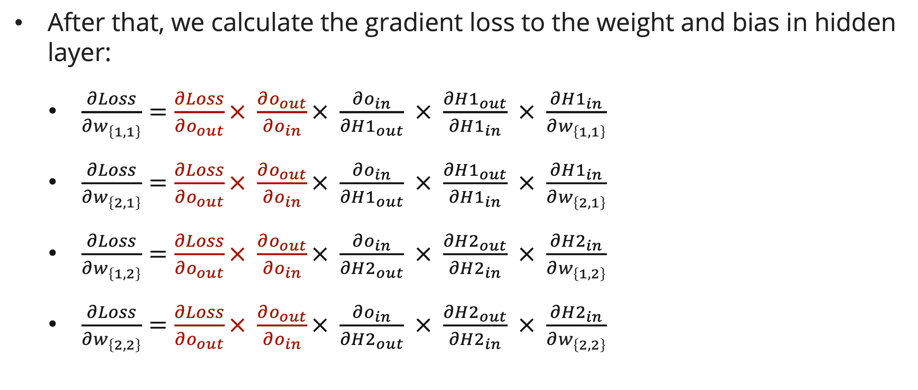
Backpropagation
example
After that, we calculate the gradient loss to the weight and bias in hidden layer:
  $\frac{∂Loss}{∂w_{\left\{1,1\right\}}}=\frac{∂Loss}{∂o_{out}}× \frac{∂o_{out}}{∂o_{in}}× \frac{∂o_{in}}{∂H1_{out}} × \frac{∂H1_{out}}{∂H1_{in}} × \frac{∂H1_{in}}{∂w_{\left\{1,1\right\}}}$
  $\frac{∂Loss}{∂w_{\left\{2,1\right\}}}=\frac{∂Loss}{∂o_{out}}× \frac{∂o_{out}}{∂o_{in}}× \frac{∂o_{in}}{∂H1_{out}} × \frac{∂H1_{out}}{∂H1_{in}} × \frac{∂H1_{in}}{∂w_{\left\{2,1\right\}}}$
  $\frac{∂Loss}{∂w_{\left\{1,2\right\}}}=\frac{∂Loss}{∂o_{out}}× \frac{∂o_{out}}{∂o_{in}}× \frac{∂o_{in}}{∂H2_{out}} × \frac{∂H2_{out}}{∂H2_{in}} × \frac{∂H2_{in}}{∂w_{\left\{1,2\right\}}}$
  $\frac{∂Loss}{∂w_{\left\{2,2\right\}}}=\frac{∂Loss}{∂o_{out}}× \frac{∂o_{out}}{∂o_{in}}× \frac{∂o_{in}}{∂H2_{out}} × \frac{∂H2_{out}}{∂H2_{in}} × \frac{∂H2_{in}}{∂w_{\left\{2,2\right\}}}$

Slide 33
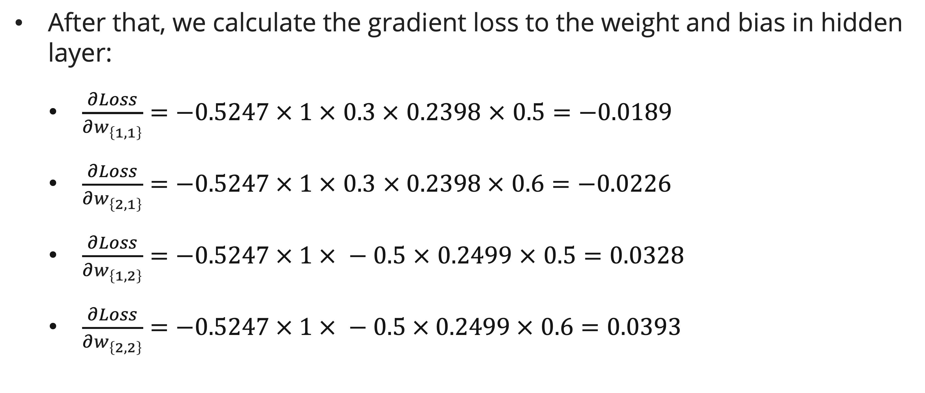
Backpropagation
example
After that, we calculate the gradient loss to the weight and bias in hidden layer:
  $\frac{∂Loss}{∂w_{\left\{1,1\right\}}}=−0.5247 × 1 × 0.3 × 0.2398 × 0.5=−0.0189$
  $\frac{∂Loss}{∂w_{\left\{2,1\right\}}}=−0.5247 × 1 × 0.3 × 0.2398 × 0.6=−0.0226$
  $\frac{∂Loss}{∂w_{\left\{1,2\right\}}}=−0.5247 × 1 × −0.5 × 0.2499 × 0.5=0.0328$
  $\frac{∂Loss}{∂w_{\left\{2,2\right\}}}=−0.5247 × 1 × −0.5 × 0.2499 × 0.6=0.0393$

Slide 34
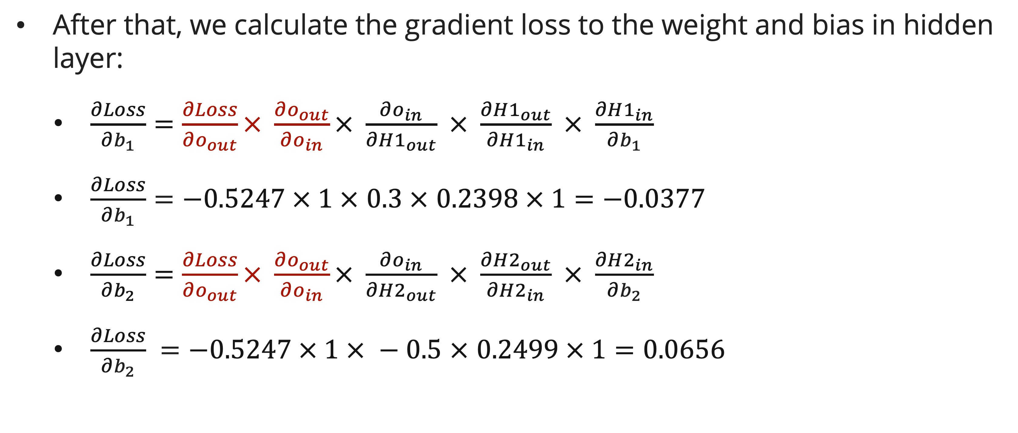
Backpropagation
example
After that, we calculate the gradient loss to the weight and bias in hidden layer:
  $\frac{∂Loss}{∂b_{1}}=\frac{∂Loss}{∂o_{out}}× \frac{∂o_{out}}{∂o_{in}}× \frac{∂o_{in}}{∂H1_{out}} × \frac{∂H1_{out}}{∂H1_{in}} × \frac{∂H1_{in}}{∂b_{1}}$
  $\frac{∂Loss}{∂b_{1}}=−0.5247 × 1 × 0.3 × 0.2398 × 1=−0.0377$
  $\frac{∂Loss}{∂b_{2}}=\frac{∂Loss}{∂o_{out}}× \frac{∂o_{out}}{∂o_{in}}× \frac{∂o_{in}}{∂H2_{out}} × \frac{∂H2_{out}}{∂H2_{in}} × \frac{∂H2_{in}}{∂b_{2}}$
  $\frac{∂Loss}{∂b_{2}} =−0.5247 × 1 × −0.5 × 0.2499 × 1=0.0656$

Slide 35
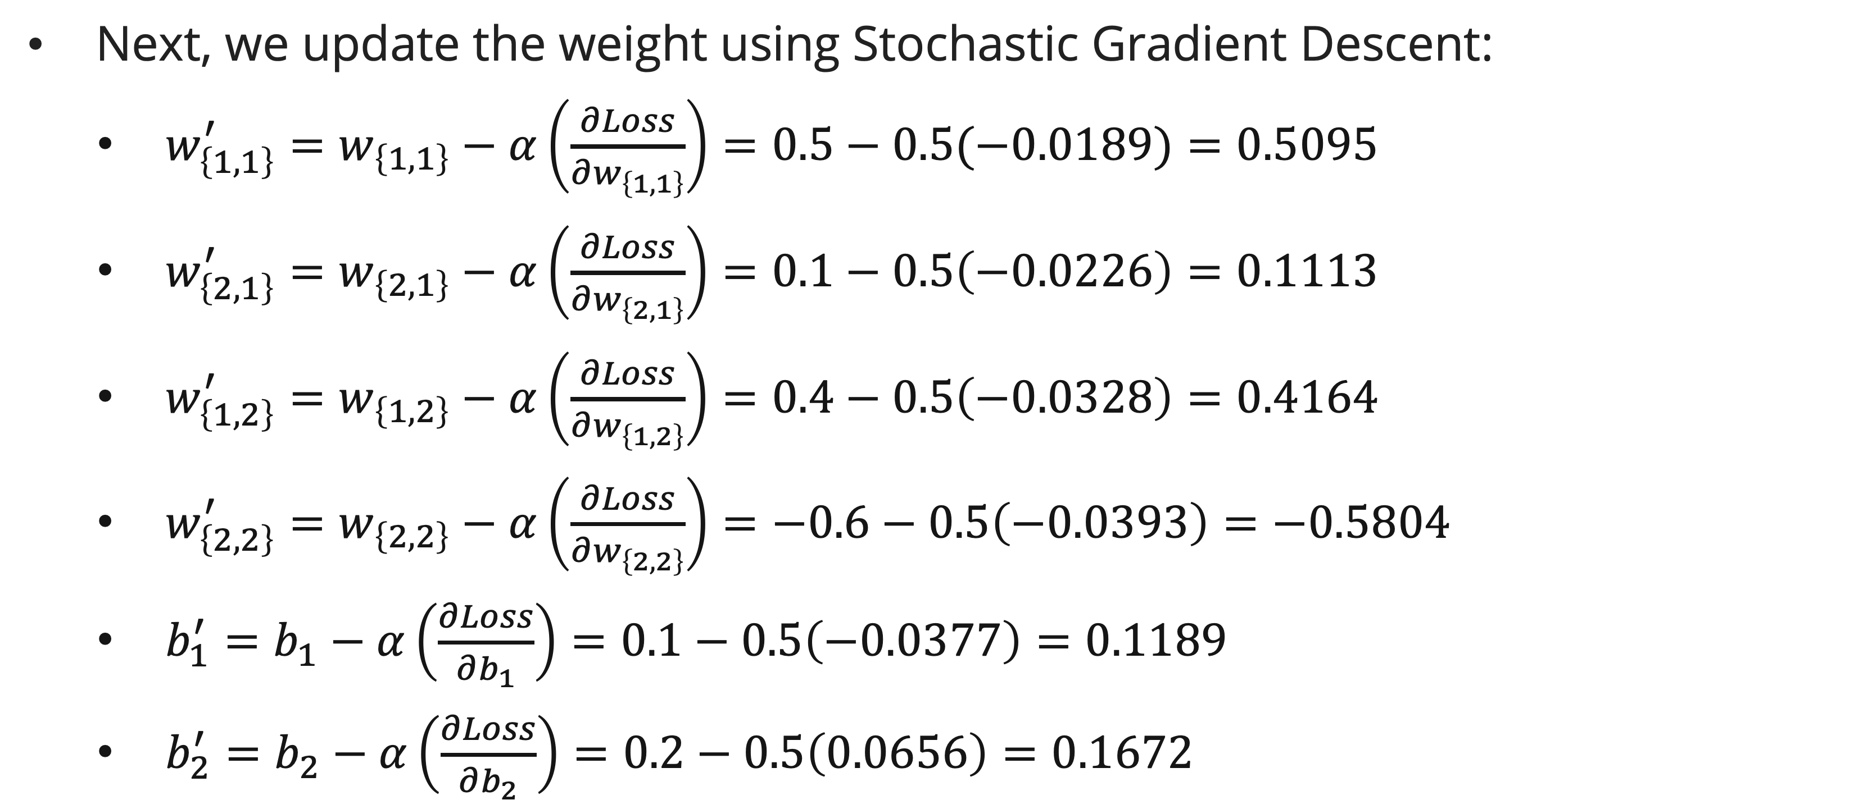
backpropagation
Example: SGD Update
Next, we update the weight using Stochastic Gradient Descent:
  $w_{\left\{1,1\right\}}^{′}=w_{\left\{1,1\right\}}−α\left(\frac{∂Loss}{∂w_{\left\{1,1\right\}}}\right)=0.5−0.5(−0.0189)=0.5095$
  $w_{\left\{2,1\right\}}^{′}=w_{\left\{2,1\right\}}−α\left(\frac{∂Loss}{∂w_{\left\{2,1\right\}}}\right)=0.1−0.5\left(−0.0226\right)=0.1113$
  $w_{\left\{1,2\right\}}^{′}=w_{\left\{1,2\right\}}−α\left(\frac{∂Loss}{∂w_{\left\{1,2\right\}}}\right)=0.4−0.5\left(−0.0328\right)=0.4164$
  $w_{\left\{2,2\right\}}^{′}=w_{\left\{2,2\right\}}−α\left(\frac{∂Loss}{∂w_{\left\{2,2\right\}}}\right)=−0.6−0.5\left(−0.0393\right)=−0.5804$
  $b_{1}^{′}=b_{1}−α\left(\frac{∂Loss}{∂b_{1}}\right)=0.1−0.5\left(−0.0377\right)=0.1189$
  $b_{2}^{′}=b_{2}−α\left(\frac{∂Loss}{∂b_{2}}\right)=0.2−0.5\left(0.0656\right)=0.1672$

Slide 36







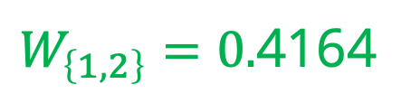

backpropagation
example
The updated weight and bias:
Let’s do a forward pass once more and check the loss/error
b
b
$$b_{\left\{1\right\}}=0.1189$$
$$b_{\left\{2\right\}}=0.1672$$
$$b_{\left\{3\right\}}=0.3124$$
$$W_{\left\{1,1\right\}}=0.5095$$
H1
$$W_{\left\{1,O\right\}}=0.4577$$
X1
O
$W_{\left\{1,2\right\}}=0.$4164
H2
$$W_{\left\{2,O\right\}}=−0.3662$$
$$W_{\left\{2,1\right\}}=0.1113$$
X2
$$W_{\left\{2,2\right\}}=−0.5804$$

Slide 37
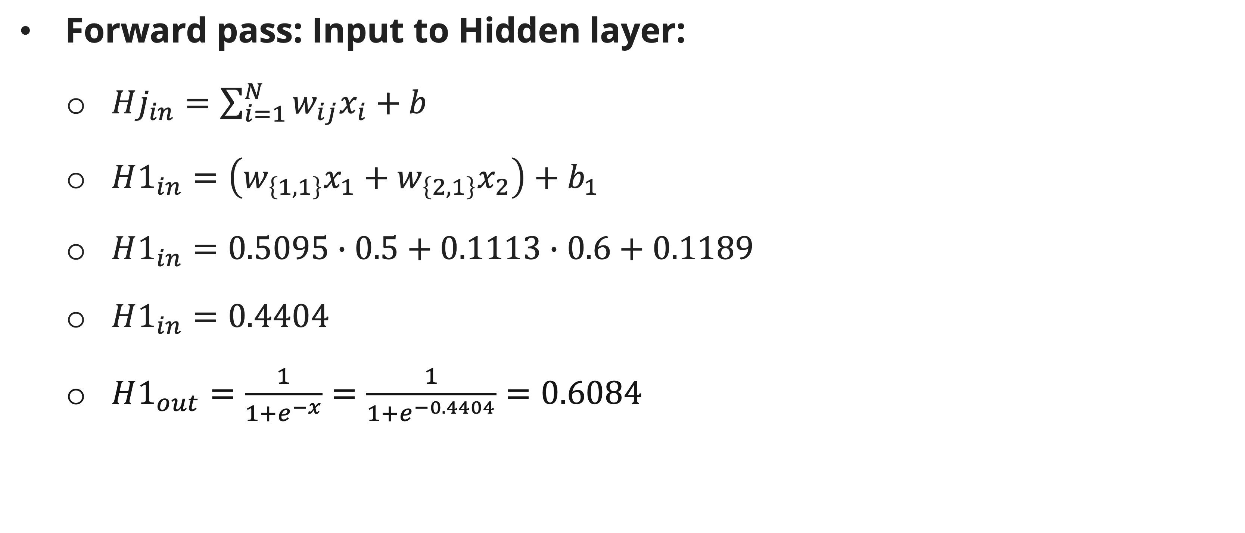
backpropagation
example
Forward pass: Input to Hidden layer:
  $Hj_{in}=\sum_{i=1}^{N}{w_{ij}x_{i}}+b$
  $H1_{in}=\left(w_{\left\{1,1\right\}}x_{1}+w_{\left\{2,1\right\}}x_{2}\right)+b_{1}$
  $H1_{in}=0.5095∙0.5+0.1113∙0.6+0.1189$
  $H1_{in}=0.4404$
  $H1_{out}=\frac{1}{1+e^{−x}}=\frac{1}{1+e^{−0.4404}}=0.6084$

Slide 38
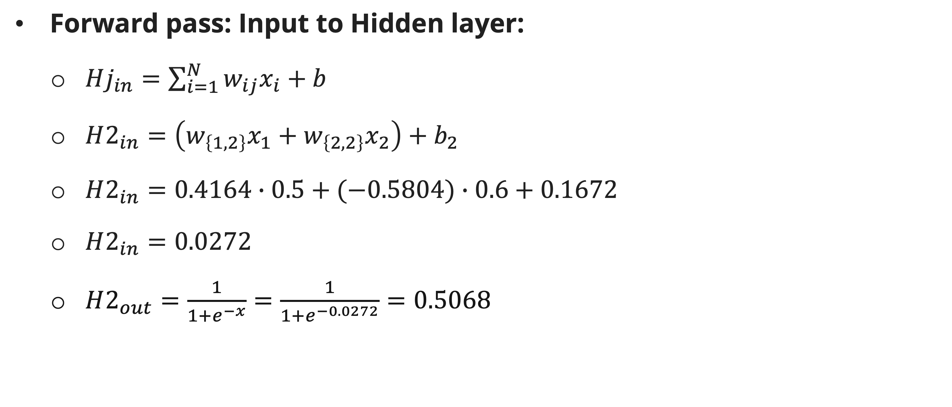
backpropagation
example
Forward pass: Input to Hidden layer:
  $Hj_{in}=\sum_{i=1}^{N}{w_{ij}x_{i}}+b$
  $H2_{in}=\left(w_{\left\{1,2\right\}}x_{1}+w_{\left\{2,2\right\}}x_{2}\right)+b_{2}$
  $H2_{in}=0.4164∙0.5+(−0.5804)∙0.6+0.1672$
  $H2_{in}=0.0272$
  $H2_{out}=\frac{1}{1+e^{−x}}=\frac{1}{1+e^{−0.0272}}=0.5068$

Slide 39
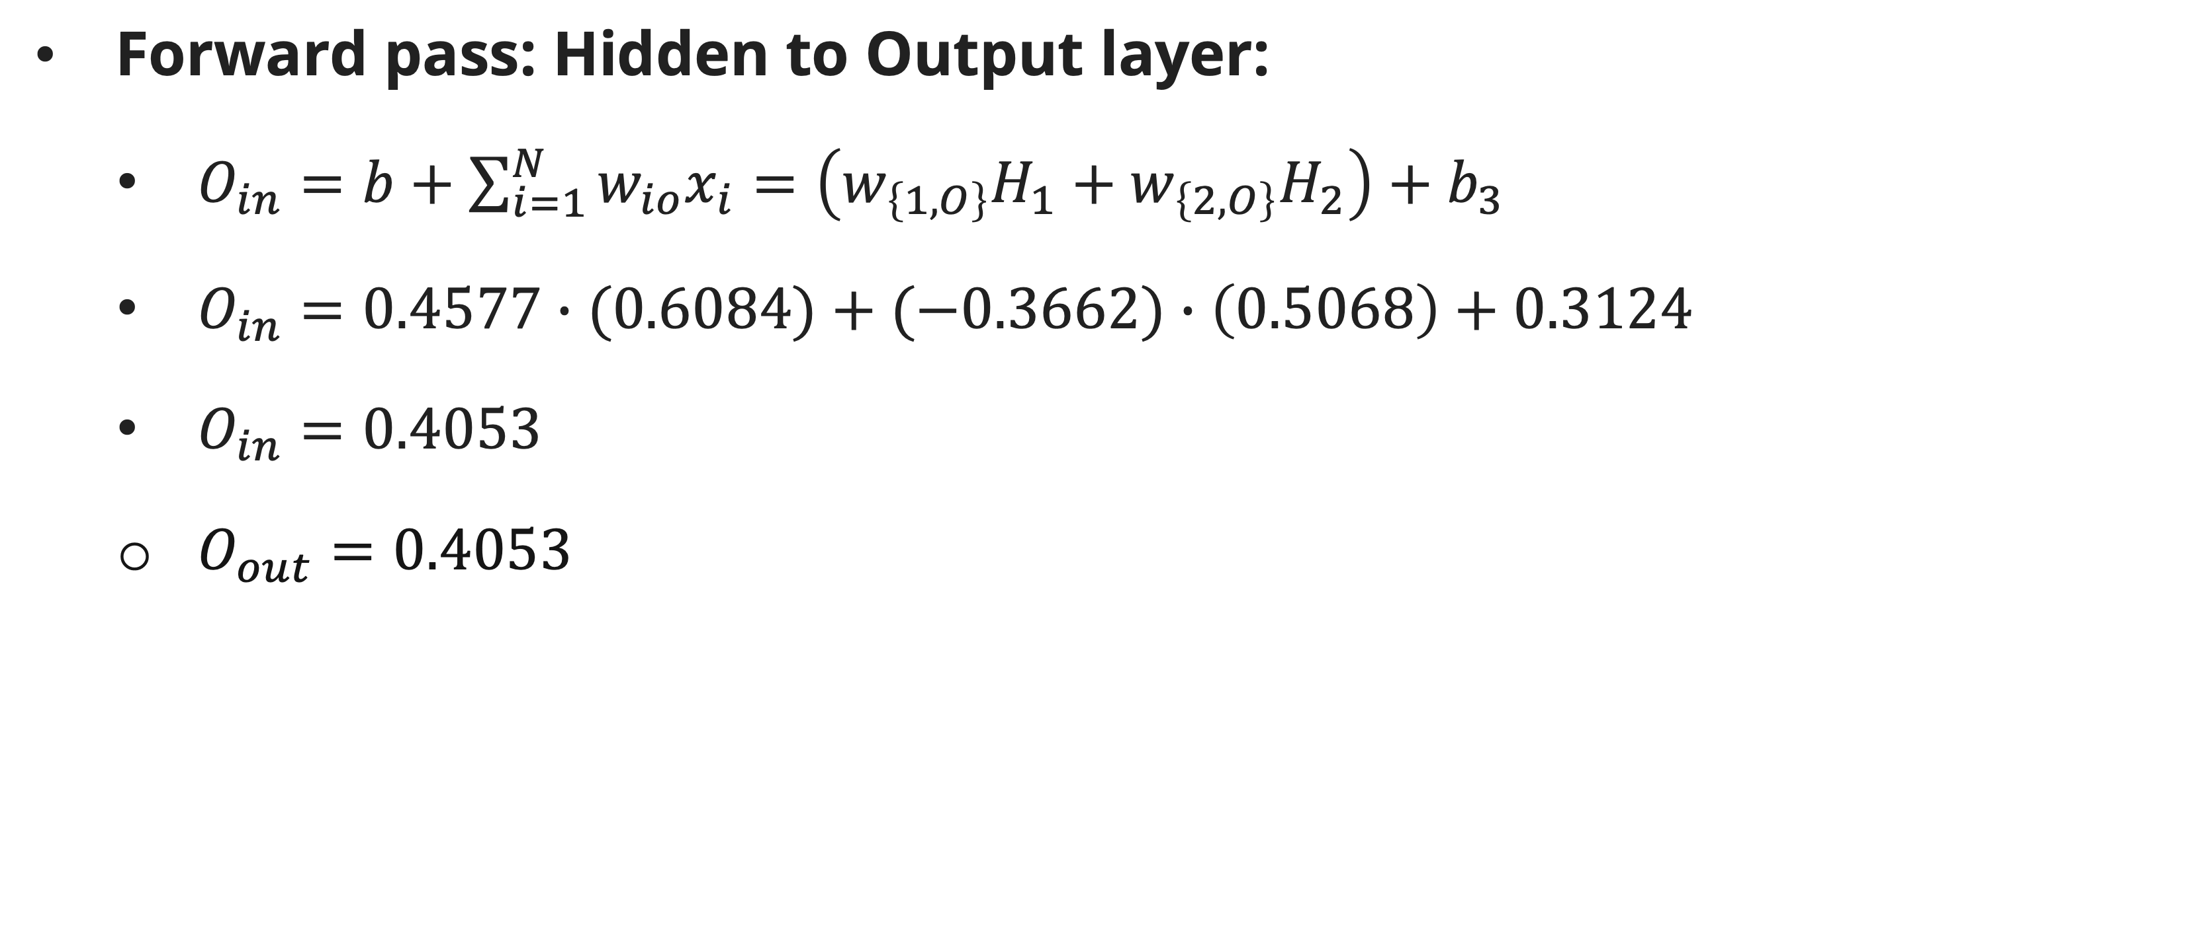
backpropagation
example
Forward pass: Hidden to Output layer:
  $O_{in}=b+\sum_{i=1}^{N}{w_{io}x_{i}}=\left(w_{\left\{1,O\right\}}H_{1}+w_{\left\{2,O\right\}}H_{2}\right)+b_{3}$
  $O_{in}=0.4577∙(0.6084)+(−0.3662)∙\left(0.5068\right)+0.3124$
  $O_{in}=0.4053$
  $O_{out}=0.4053$

Slide 40
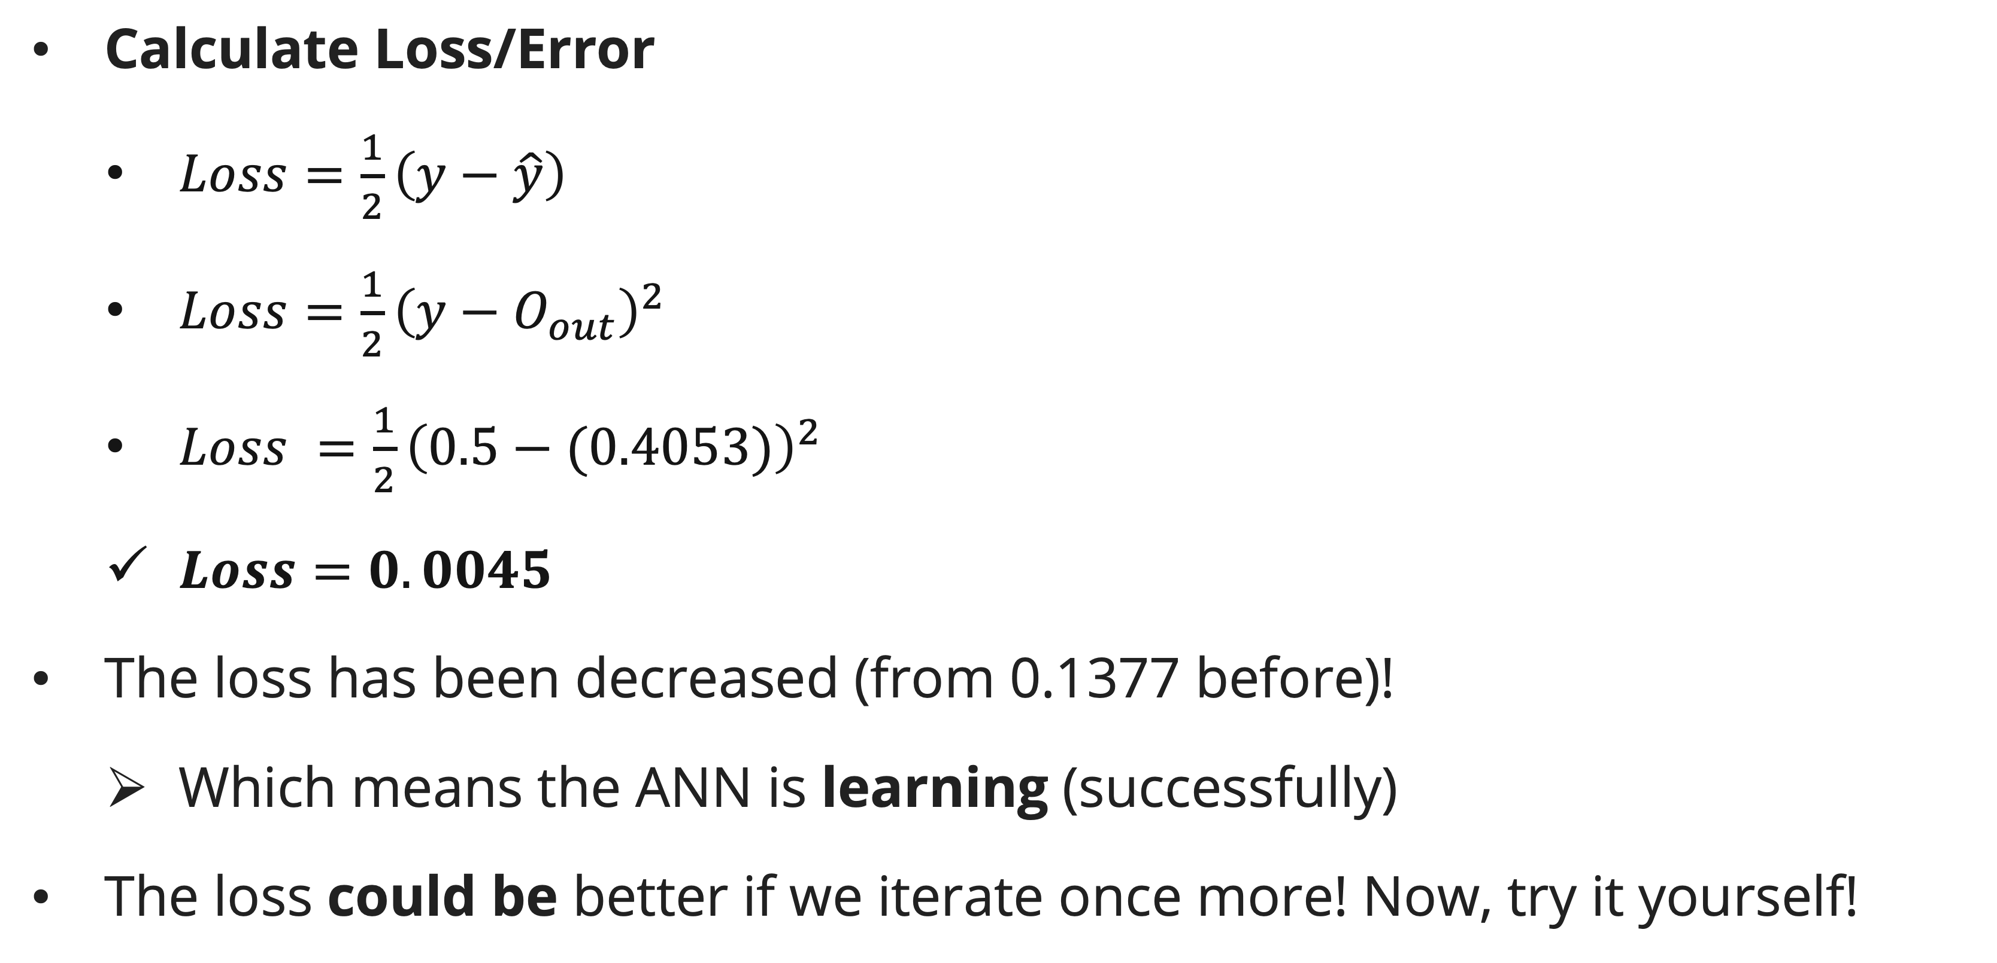
backpropagation
example
Calculate Loss/Error
  $Loss=\frac{1}{2}\left(y−\hat{y}\right)$
  $Loss=\frac{1}{2}{\left(y−O_{out}\right)}^{2}$
  $Loss =\frac{1}{2}{\left(0.5−(0.4053)\right)}^{2}$
  $Loss=0.0045$
The loss has been decreased (from 0.1377 before)!
  Which means the ANN is learning (successfully)
The loss could be better if we iterate once more! Now, try it yourself!

Slide 41
Backpropagation
Discussion
If we increase/decrease the learning rate, it could affect the learning progression
  Increasing will fasten the learning progression but make the the learning more chaotic (could be trapped in local optima);
  Decreasing will give a more stable learning but slow down the learning progression.
The one we used in example is SGD, where weight is updated (backward pass is done) for a single data, there are other variation:
  Batch gradient descent = only do backward pass once all the data has been passed forwardly using the mean error.
  Mini-batch gradient descent = Between SGD and BGD, do backward pass for every mini-batch of data, for example for every 8 or 16 data, using the mean error of that mini-batch.

Slide 42
References
Session 24
Peter Norvig, Stuart Russel. (2021). Artificial Intelligence: A Modern Approach. Pearson. London. ISBN: 978-1292401133. Ch. 19-20.
Alrabeiah, M. (2022). Neural Networks: From The Ground up. https://faculty.ksu.edu.sa/sites/default/files/L3_1.pdf
Sena, S. (2017, November 3). Pengenalan Deep Learning Part 3: BackPropagation Algorithm. Medium. https://medium.com/@samuelsena/pengenalan-deep-learning-part-3-backpropagation-algorithm-720be9a5fbb8
Michael A Nielsen. 2015. “Neural Networks and Deep Learning”, Determination Press
Victor Lavrenko. (n.d.). Backpropagation: how it works [Video]. YouTube. https://www.youtube.com/watch?v=An5z8lR8asY

